Slide 1
GOAL Statement 3 North Carolina’s Forest Resources Assessment A statewide analysis of the past, current and projected future conditions of North Carolina’s forest resources
Bill Pickens
Conifer Silviculture
bill.pickens@ncdenr.gov

Slide 2
Goal Statement 3.—Increase the restoration, maintenance, and management of fire-adapted species and ecosystems
Fire shaped many ecosystems in NC
Fire exclusion
Through the use of prescribed fire
Increase capacity
Research
Develop models and techniques
Educate
Focus on Longleaf Pine and other fire-adapted ecosystems.

Slide 3
Goal Statement 3.—Increase the restoration, maintenance, and management of fire-adapted species and ecosystems.
Objective 3.1.—Promote a greater acceptance of prescribed fire and its increased use.
Objective 3.2.—Restore and conserve fire-adapted species, habitats, and forest ecosystems
Objective 3.3.—Restore and conserve longleaf pine forests.

Slide 4
Goal 3 – in North Carolina’s Forest Resources Assessment
Based on references and findings in….
Chapter 2b. – Declining Forest Types
Chapter 2c. - Management Practices for Forestry and Wildlife.
Chapter 3b. – Fire Exclusion in NC Forests
Chapter 4g. – Forest Wildlife Habitat
And
Chapter 2f. – Emerging Markets in Ecosystem Services.
Chapter 3a. Insects, Diseases, and Non-native Invasive Plants: Threats to Forest Health

Slide 5
2b. Declining Forest Types
Key Finding
The volume and extent of longleaf pine, Atlantic white cedar, and shortleaf pine, species with ecological and economic importance, has significantly declined in North Carolina.

Slide 6
2b. Declining Forest Types
Lost 73,000 acres of LL (FIA data)
Fire exclusion has contributed to LL decline.
Only 91 of 352 remnant stands maintained by fire. Frost 1993
Shortleaf – 70% decline (FIA data)

Slide 7
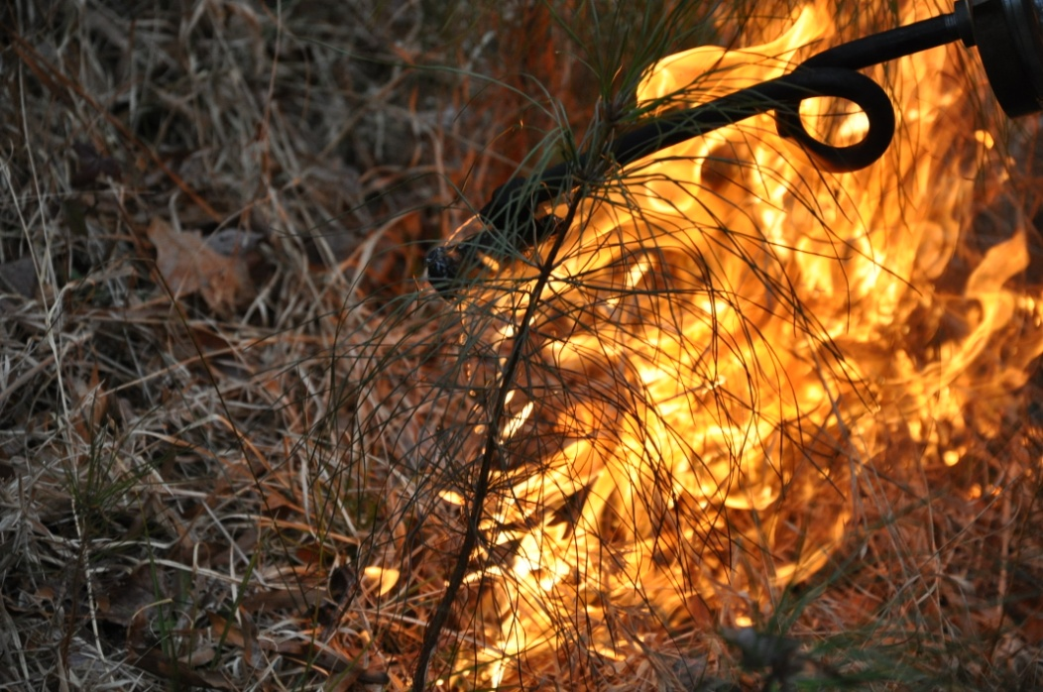
2c. - Management Practices for Forestry and Wildlife
Key Finding
Prescribed fire is an effective management activity to enhance and maintain many NC forest habitat types and fire-dependent ecosystems.

Slide 8
2c. - Management Practices for Forestry and Wildlife
118,779 acres – average annual prescribe burn(2000-2005). pp93
2/3 HRB
70 percent on the coastal plain
NC Prescribe Fire Act
NC Prescribe Fire Council
NC Prescribe Fire Awareness Week
Fire exclusion threatens the health and existence of many native plant communities and the wildlife they support. pp94

Slide 9
3b. – Fire and Fire Exclusion in NC Forests
Key Findings
Fire exclusion contributes to the decline or loss of fire-dependent ecosystems and species, and creates fuel conditions that produce destructive wildfires
Smoke-sensitive areas occur in much of North Carolina. These areas and air quality regulations restrict controlled burning and necessitate coordinated planning at state, regional, and national levels.

Slide 10
3b. – Fire Exclusion in NC Forests
Lack of prescribe burning is a primary cause of increased fuel loading. pp132
Fire contributes to the diversity of plant communities supporting fire-dependent and fire-adapted ecosystems in NC. pp132

Slide 11
3b. – Fire Exclusion in NC Forests
Many residents ….are not aware of the benefits that prescribed fire has on an ecosystem. pp134
It will take working cooperatively to address smoke management and facilitate the planned increased burning….while complying with state and federal air quality laws. pp134

Slide 12
4g. – Forest Wildlife Habitat
Key Findings
North Carolina has a large diversity of wildlife species, many of which are in decline because the forest ecosystems upon which they depend are in decline.
Many forest types, and thus the wildlife that depend upon them, continue to suffer from common threats, including development ;conversion to monocultures or non-historic forest types; fragmentation; fire exclusion; pests, nonnative pathogens, and exotic species; logging; lack of management; and altered hydrology.

Slide 13
4g. – Forest Wildlife Habitat
Ten out of the 17 primary forest types across the state list fire suppression, lack of fire, or fire exclusion as a threat. Table 4g-1; pp 202 -204
“Without fire oaks and shrubs increase in dominance”…..Longleaf pine forest
“Table mountain pine and pitch pine can only reproduce in a fire maintained system.”…… Dry coniferous woodlands; mountain eco-region
“Fire suppression affects species diversity and richness and composition, structure, and diversity” …. Oak forests; mountain and piedmont
“Atlantic white cedar forest……overall abundance and distribution has been greatly reduced by lack of fire…” Pocosins

Slide 14
Goal Statement 3.—Increase the restoration, maintenance, and management of fire-adapted species and ecosystems
To meet this goal we must….
Promote the application of prescribed fire
Conduct research
Increase resource capacity
Publicize fires importance, value, and benefit.
Identify and support management and conservation of longleaf pine and other fire adapted ecosystems

Slide 15
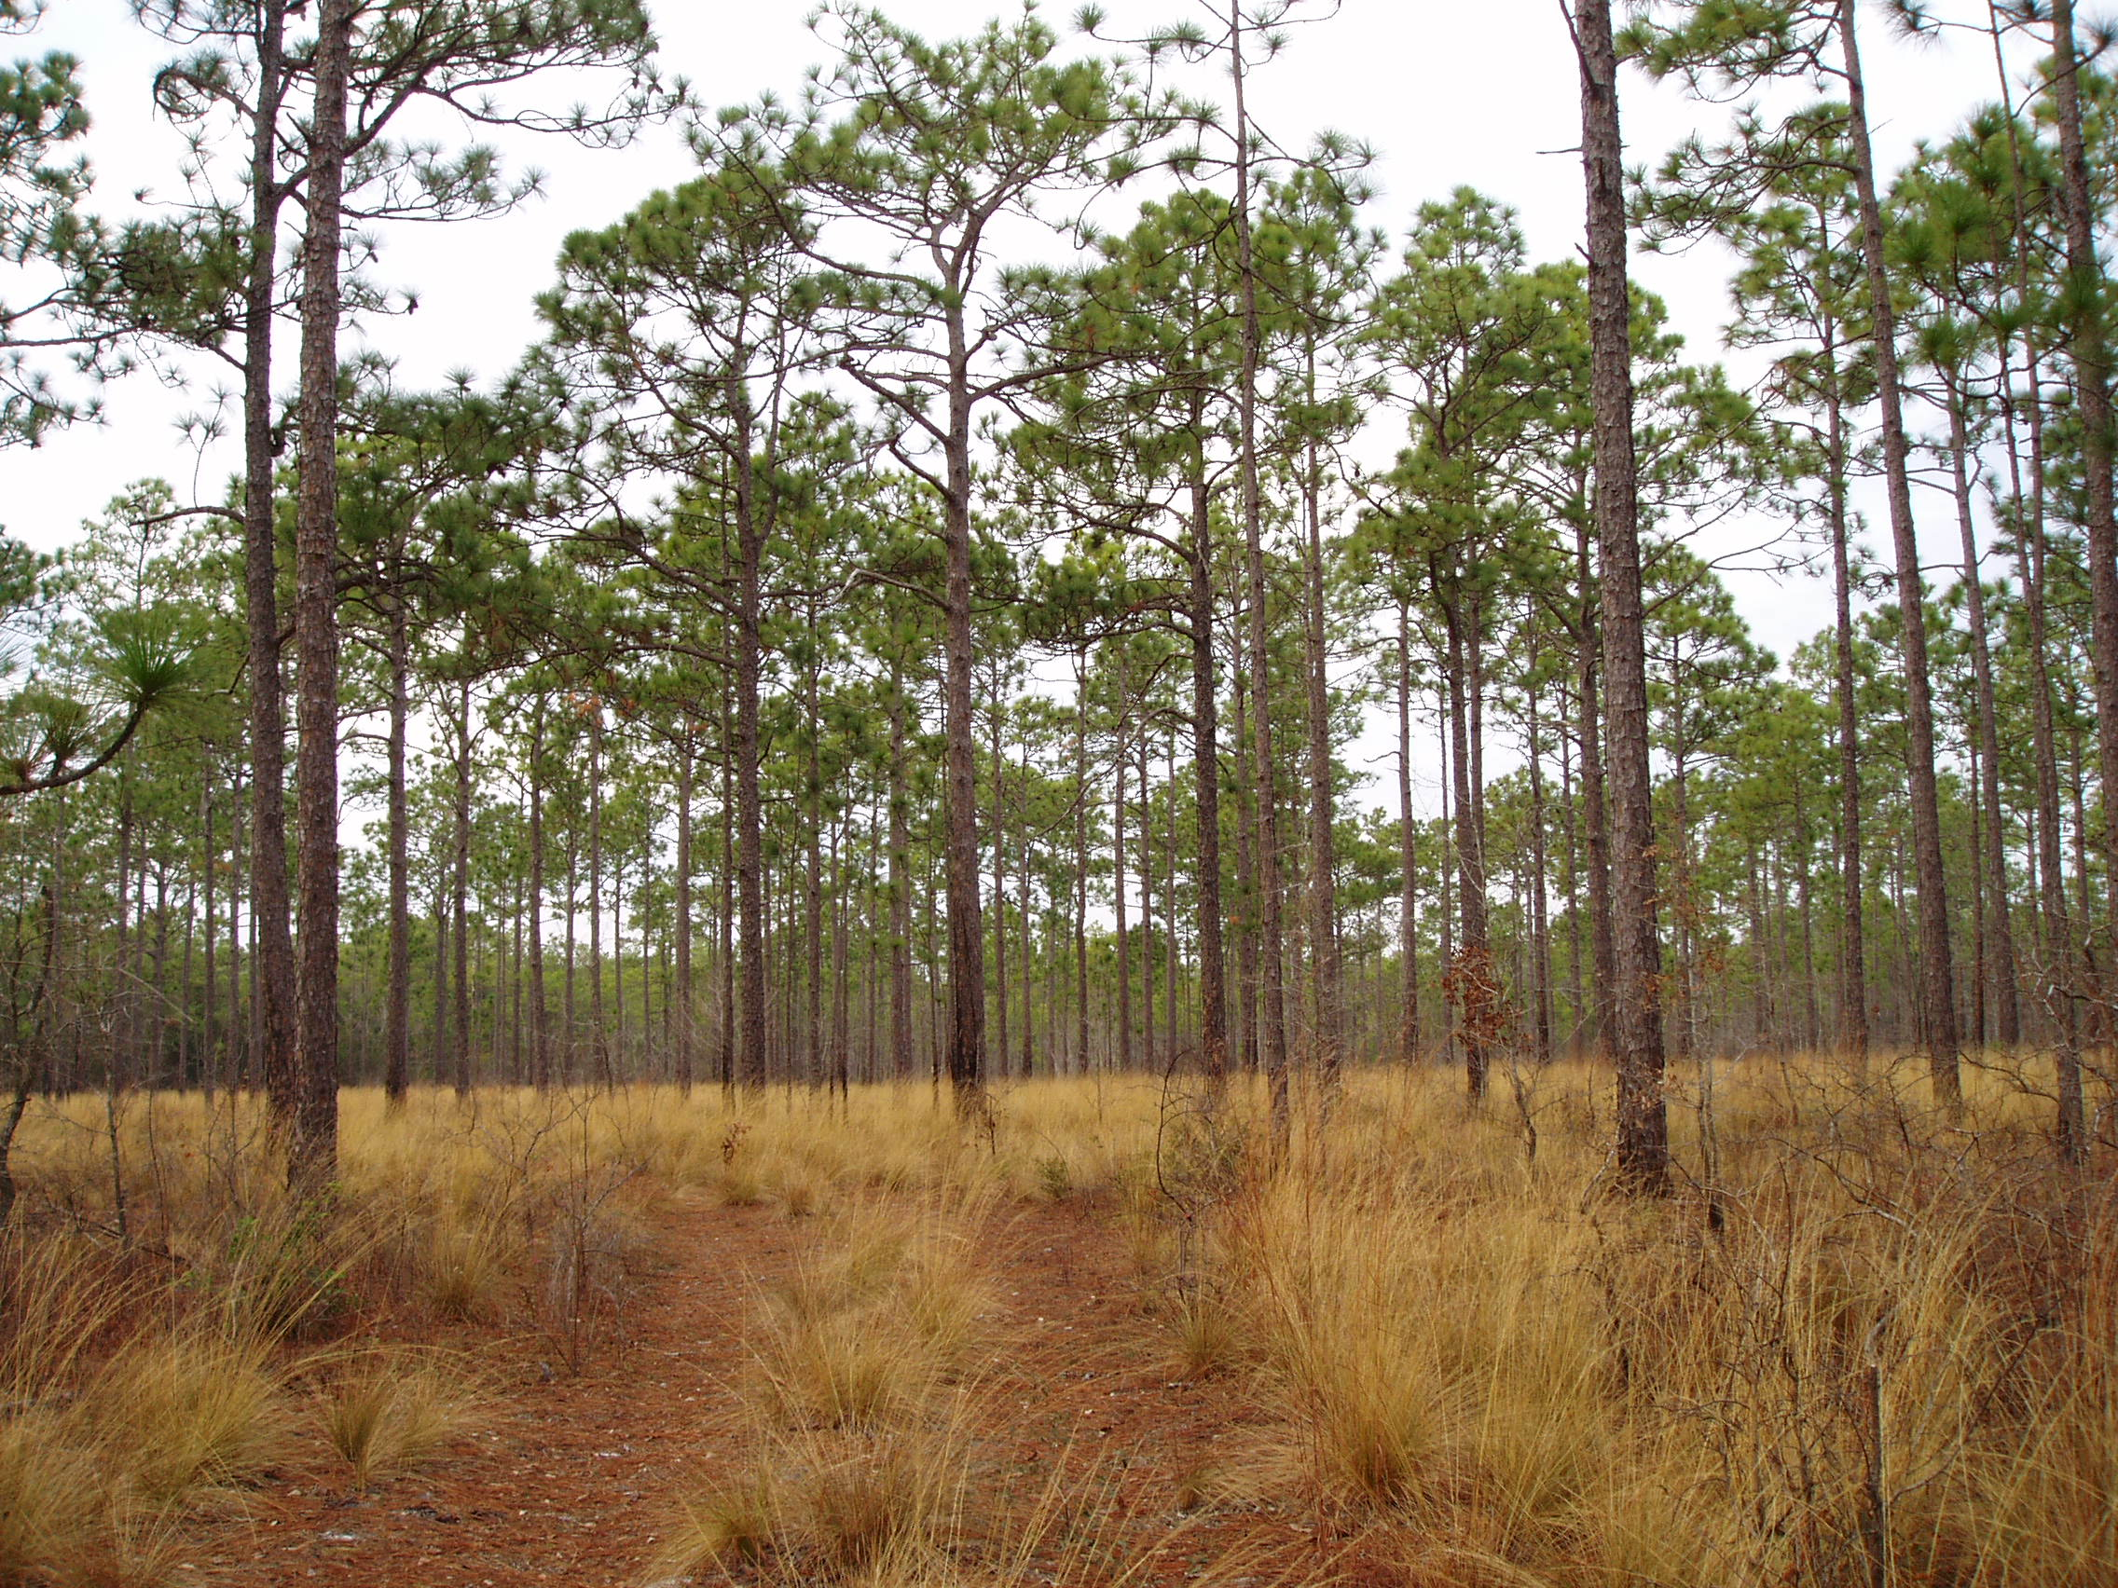
QUESTIONS??

