Slide 1
The Potential of American Sycamore as a Bioenergy Feedstock and Alternative Land Use for Multiple Ecosystem Services
John S. King
Department of Forestry and Environmental Resources
North Carolina State University
2025 Research/Industry Update Meeting
New and Emerging Crops Program, NCDACS
NC State Fairgrounds
March 6, 2025

Slide 2
Outline
1. Environmental stress and farming
2. Opportunities for integrating bioenergy into forestry and agriculture
3. American sycamore: Unrecognized potential
4. The future

Slide 3
1. Environmental stress and farming

Slide 4
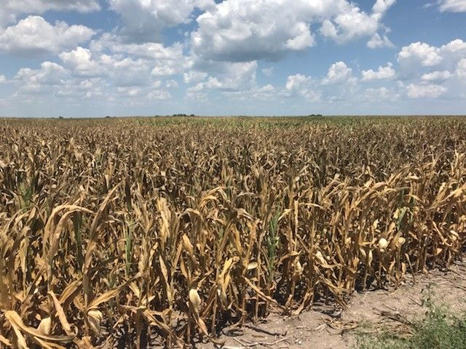
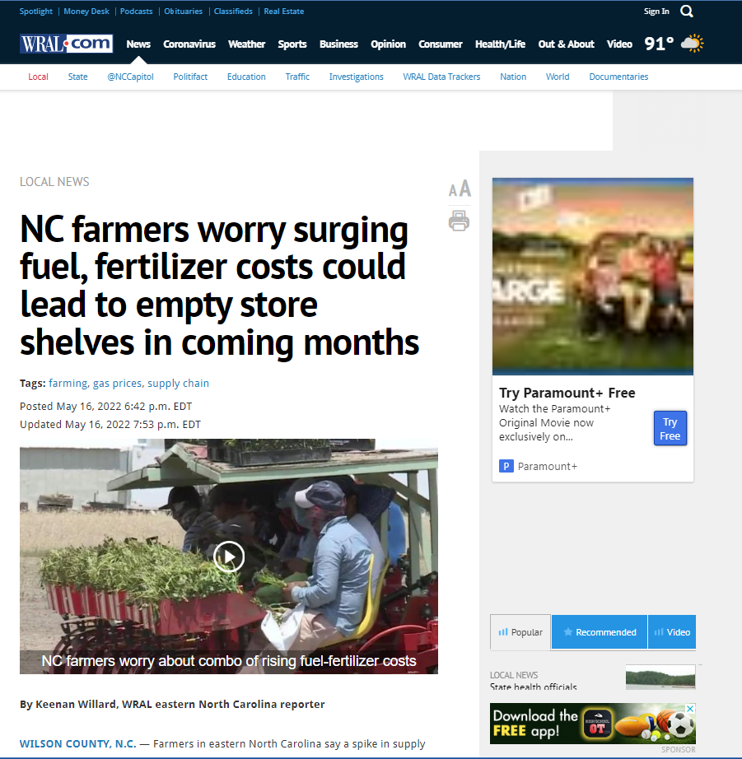

Slide 5
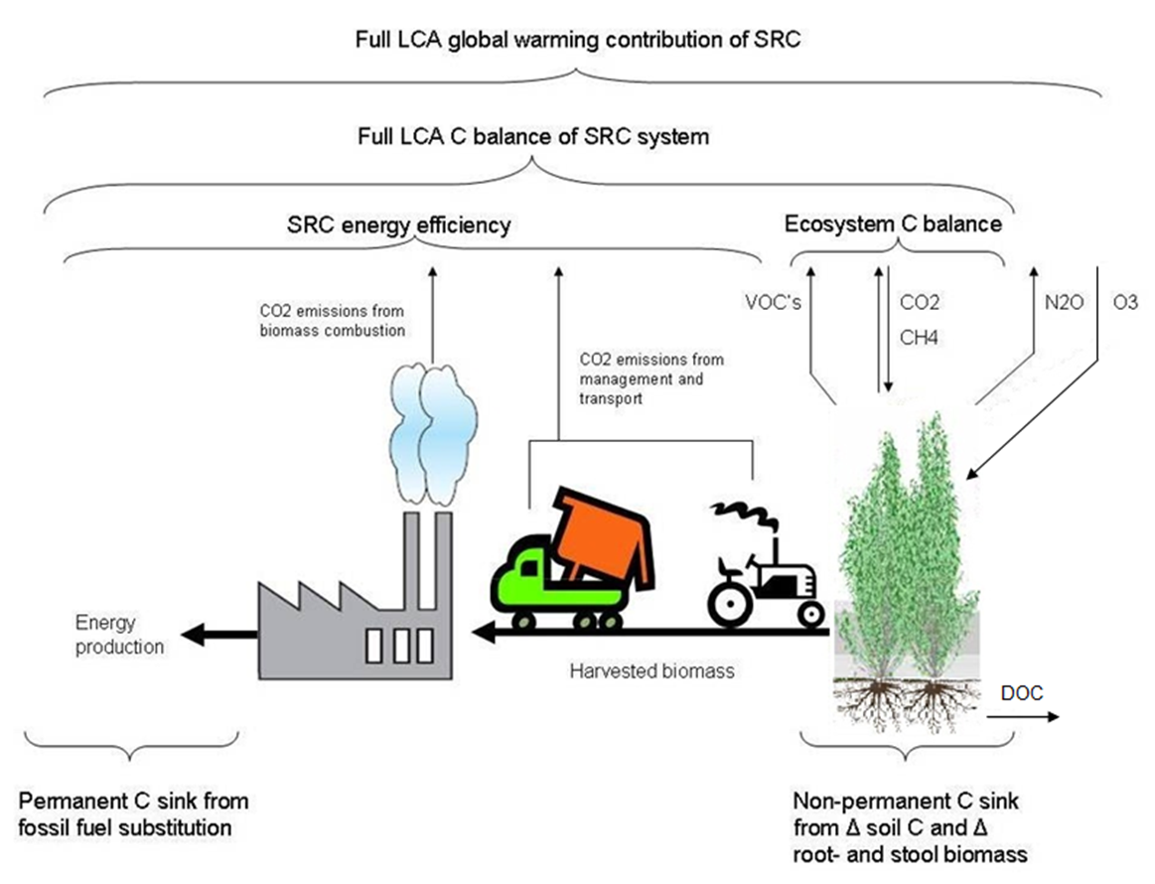
Bioenergy in an increasingly STRESSFUL world!
POPFULL Project, University of Antwerp, R. Ceulemans

Slide 6
Ecophysiology as an applied science
Taxa | Avg Ps (umol per m² per s) | Avg gs (mmol per m² per s) | Avg WUEi £ (µmol per mmol) | δ¹³C | Avg Tree ANPP (Mg per ha per y) | Avg Under- story ET (mm per y) | Avg Stand T (mm per y) | Avg Stand WUE* (kg per mm) | Bio energy WUE** (MJ per m³) | Avg MAT (°C) | Avg MAP (mm) | MAP/ AET# (mm) | Notes
Acer pseudopl. | 6.5 | 165.2 | 0.039 | - | 1.2 | - | - | - | - | 10.0 | 877 | - | A
Acer rubrum | 7.7 | 175.2 | 0.044 | - | 1.3 | - | - | - | - | 9.2 | 1186 | - | B
Alnus | 7.9 | 81.0 | 0.097 | -28.8 | 9.0 | 230.0 | 538.0 | 16.8 | 28.1 | 11.3 | 1305 | 1.7 | C
Eucalyptus | 16.8 | 396.0 | 0.042 | -27.3 | 17.5 | - | 1054 | 16.5 | 27.7 | 20.5 | 1309 | - | D
Larix | 7.0 | 56.0 | 0.125 | -26.4 | 1.0 | 62.0 | 101.0 | 6.3 | 10.6 | -8.7 | 230 | 1.4 | E
Liquidambar | 8.6 | 280.0 | 0.031 | -27.4 | 4.4 | 205.0 | 462.5 | 9.4 | 15.8 | 15.7 | 1304 | 1.9 | F
Liriodendron | 8.9 | 102.1 | 0.087 | - | 0.9 | - | - | - | - | 13.0 | 1692 | - | G
Pinus | 4.7 | 99.0 | 0.047 | -27.3 | 5.0 | 251.8 | 410.0 | 12.3 | 20.5 | 16.6 | 1145 | 1.7 | H
Platanus | 9.5 | 286.5 | 0.033 | - | 5.5 | - | 293.8 | 18.9 | 31.5 | 18.4 | 1019 | - | I
Populus-pure sp | 13.7 | 303 | 0.045 | -28.0 | 10.1 | 117.0 | 419.2 | 24.0 | 40.2 | 11.4 | 607 | 1.1 | J
Populus-hybrids | 12.7 | 343 | 0.037 | -28.1 | 8.1 | 142.5 | 439.1 | 18.5 | 30.9 | 10.2 | 753 | 1.3 | J
Quercus | 10.4 | 185.5 | 0.056 | -27.8 | 7.2 | - | 294.8 | 24.3 | 40.6 | 13.6 | 913 | - | K
Robinia | 9.7 | 296.7 | 0.033 | -24.3 | 8.8 | 370.0 | 204.5 | 43.2 | 72.2 | 10.9 | 700 | 1.2 | L
Salix-pure sp | 13.7 | 316.0 | 0.043 | -27.9 | 8.4 | 240.1 | 403.8 | 20.7 | 34.6 | 5.7 | 661 | 1.0 | M
Salix-hybrids | 20.6 | 378.0 | 0.054 | - | 8.0 | 119.4 | 324.9 | 24.5 | 41.1 | 6.6 | 703 | 1.2 | M
Spatially-explicit representation of forest-ag land biotic structure and process rates, linked to climate driven models for regional integration
King et al. 2013

Slide 7
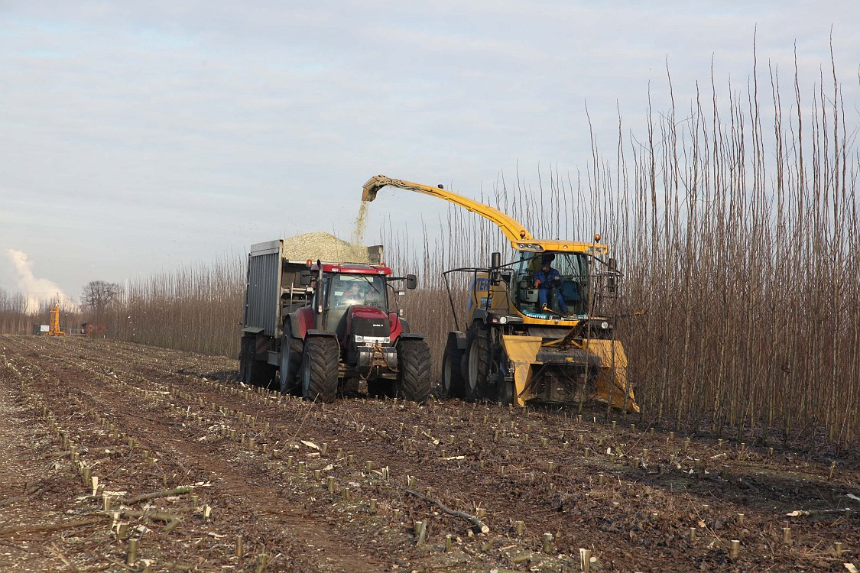
2. Opportunities for integrating bioenergy into forestry and agriculture
Bioenergy intercropping as an example
Economic diversification
Rural economic development (harvesting, handling, processing bioenergy)
Integrate bioenergy cropping with agriculture
More research is needed
Development of markets
Added product streams for farmers
Restoration of soil properties and biodiversity
SOC, nutrients, soil structure, decreased nematodes, etc.
Increase biodiversity of agricultural landscapes
Improve climate profile of agricultural landscapes
Regional and national C balance, impacts on water
Fossil fuel offsets
Energy security
C sequestration in soils
Must understand effects on regional water cycling
Photo credit: R. Ceulemans, POPFULL, U Antwerp

Slide 8
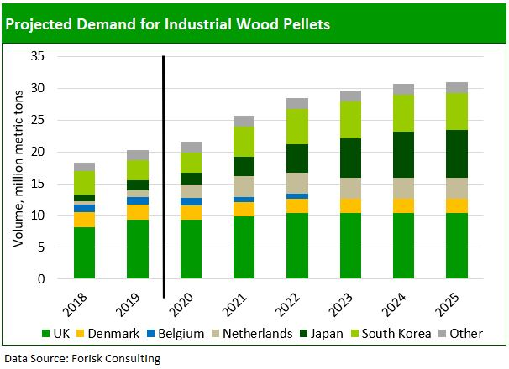
Strong and growing demand
FORISK, 2022
US densified biomass (wood pellets) production facilities by state, region, and capacity, March, 2018 (US EIA).

Slide 9
3. American sycamore: Unrecognized potential
Native species with wide range of environmental tolerances
HIGH tolerance of biotic and abiotic stress
Tolerates both drought and flooding, not many pests
Moderate to very good productivity with LOW INPUT culture
Seedling production capacity at scale available
Reliable, low cost establishment with existing technology
Excellent coppicing and ability to outcompete weeds
Great potential for tree improvement programs – productivity, drought tolerance, salt tolerance(?), resistance to diseases
Excellent wood properties and uniformity for bioenergy feedstock at scale
Good energy content (19-20 MJ kg⁻¹), dries well, thin bark/low ash content
Capacity to improve agricultural soil health and biodiversity
Chemical, physical and biological properties
Improves farm-scale and regional carbon and water cycling

Slide 10
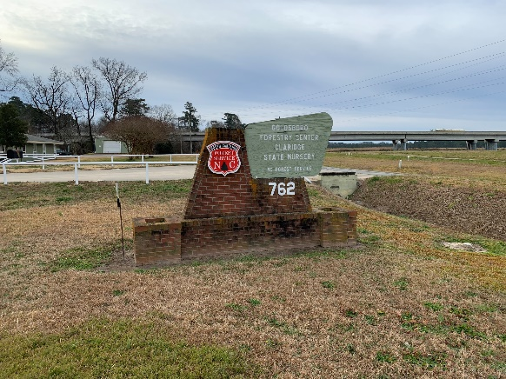
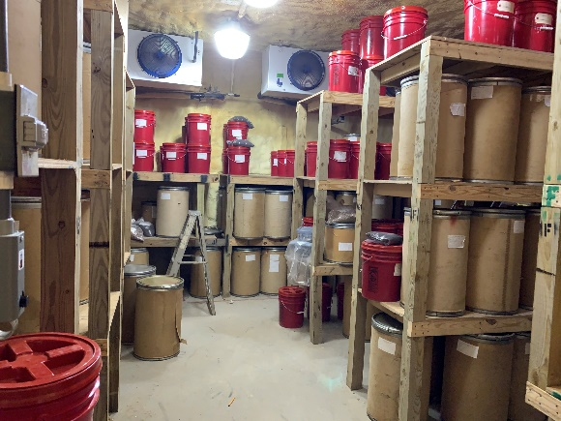
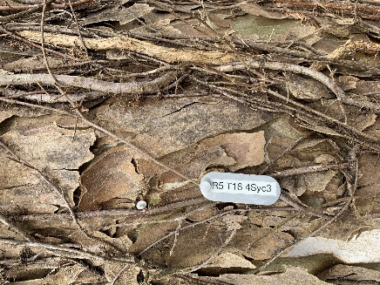
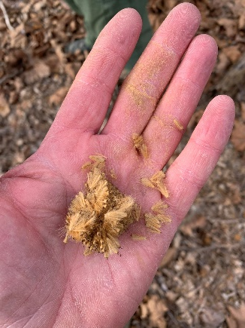
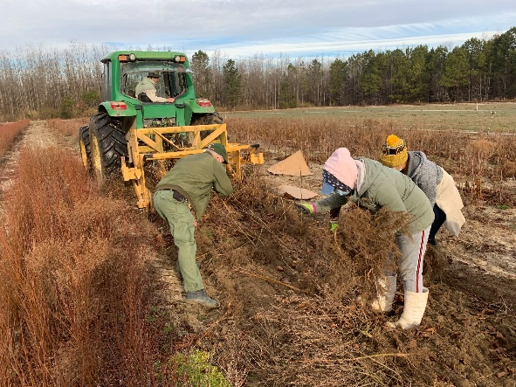
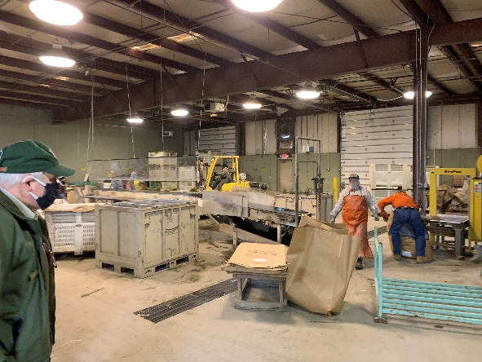
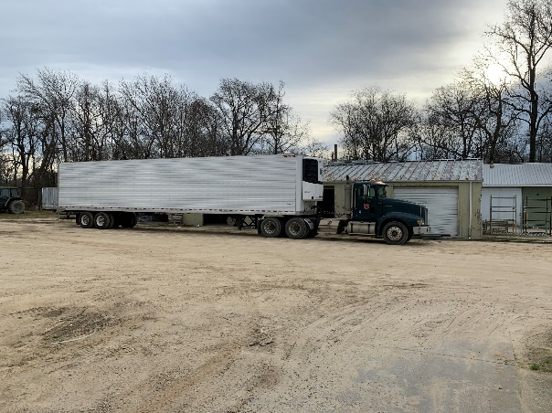
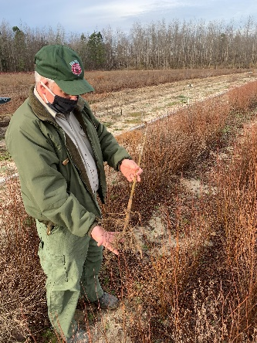
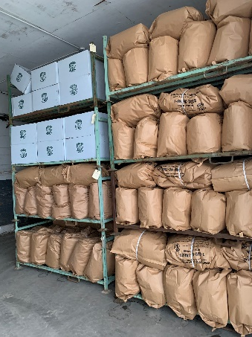
Seed source and establishment
NC Forest Service Claridge Nursery
Goldsboro, NC

Slide 11
Cropping Systems Study – Butner, NC
Winter 2009/2010
14m x 14m plot
3m spacing btwn plots
main road
P25
2
1
5
5
5
1
2
2
1
2
5
1
Block 3
1
1
1
1
1
2
2
2
5
2
2
5
P13
P1
2
5
5
2
5
1
5
1
5
5
2
1
P25
5
2
2
5
2
5
1
5
2
1
2
5
Block 2
5
1
P13
5
1
1
2
5
5
1
5
1
2
P1
5
2
1
1
1
1
2
2
5
2
2
1
dirt track
P25
2
1
2
1
5
1
1
2
1
5
2
1
Block 1
P13
1
2
5
2
5
2
2
5
5
1
1
5
P1
5
1
5
2
2
2
1
1
5
2
5
5
150 m
Squaring off point
5
1
2
rainfall control
201 m
Rainfall reduction
NM6
Ypop
Syc
Pdelt
N*Y
N*S
0.5m
1m
2m

Slide 12
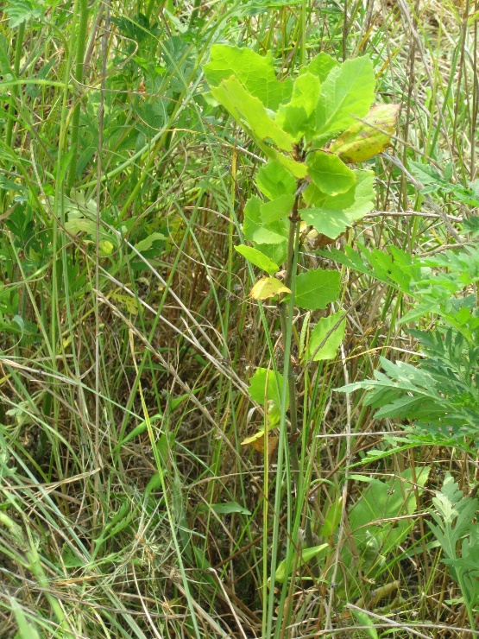
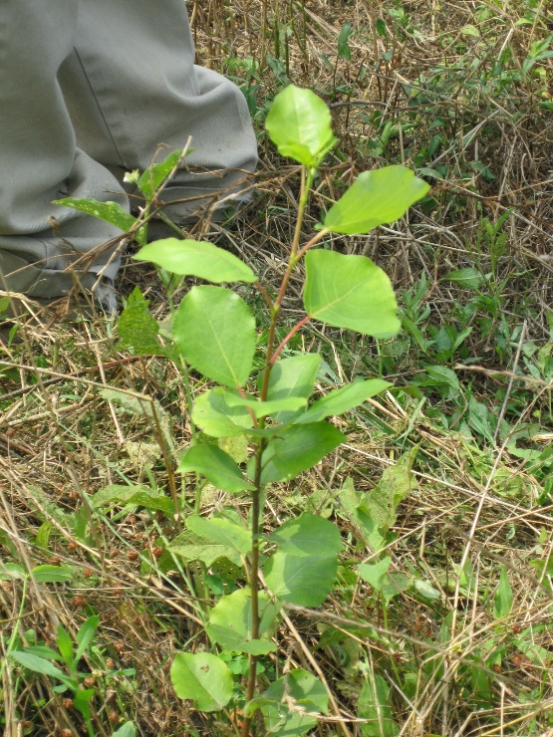
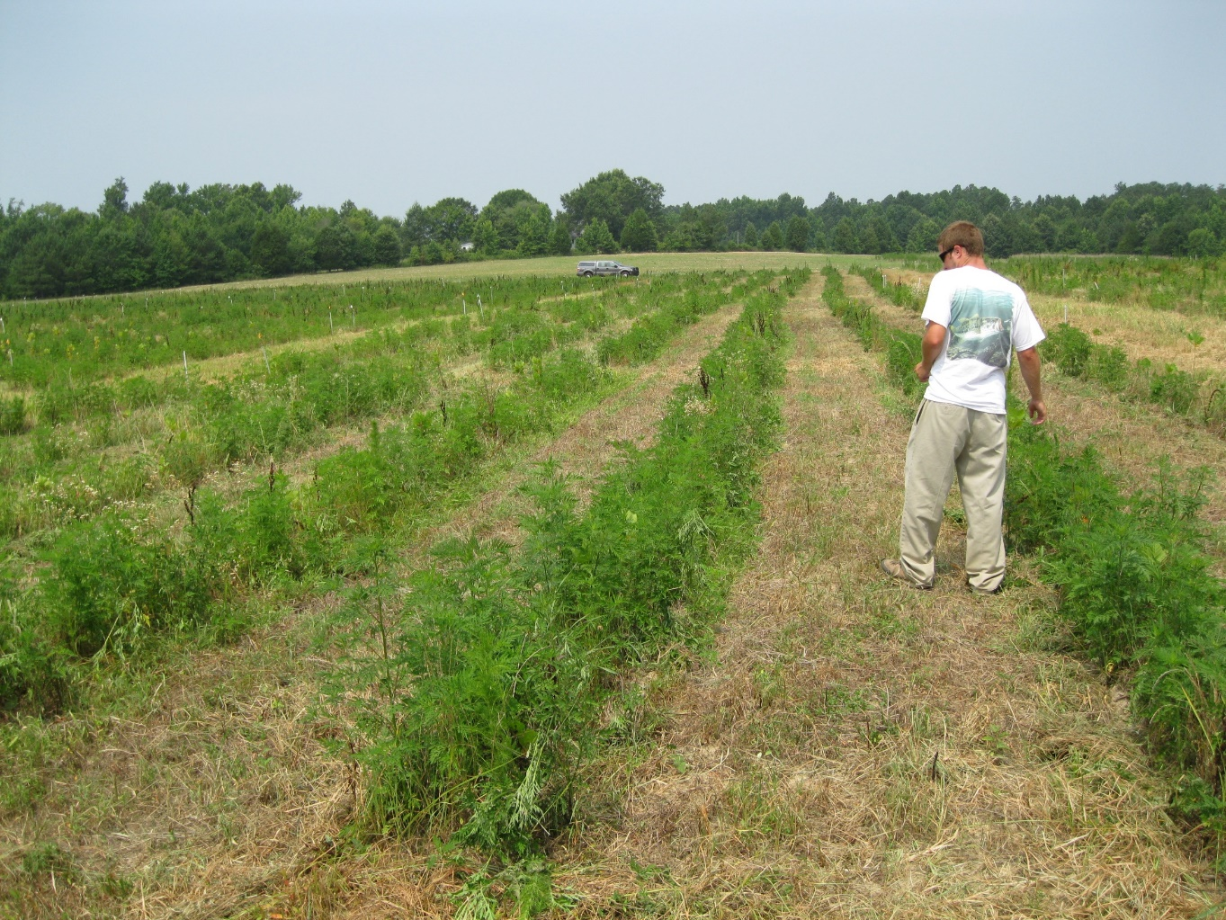
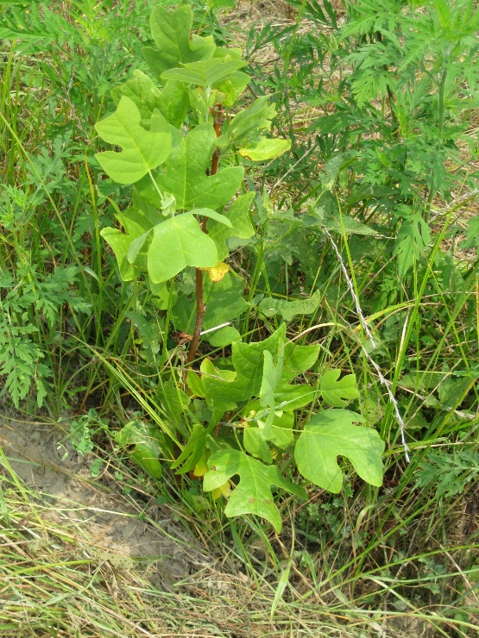
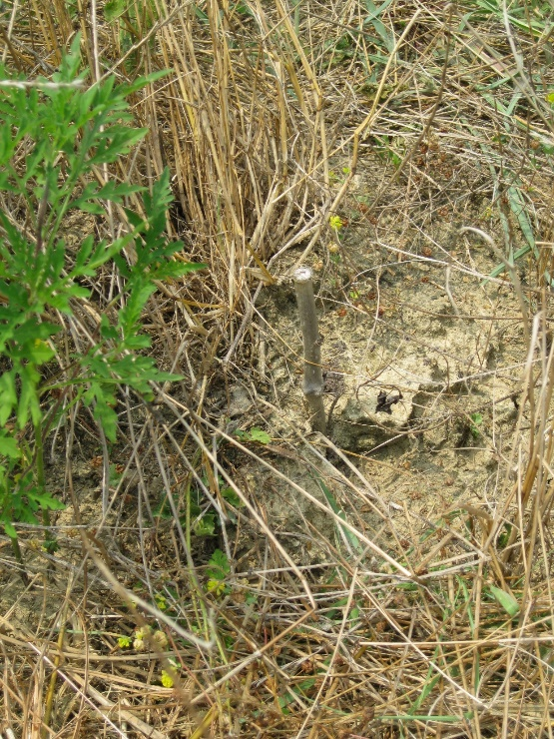
July 2010
Note low input culture

Slide 13
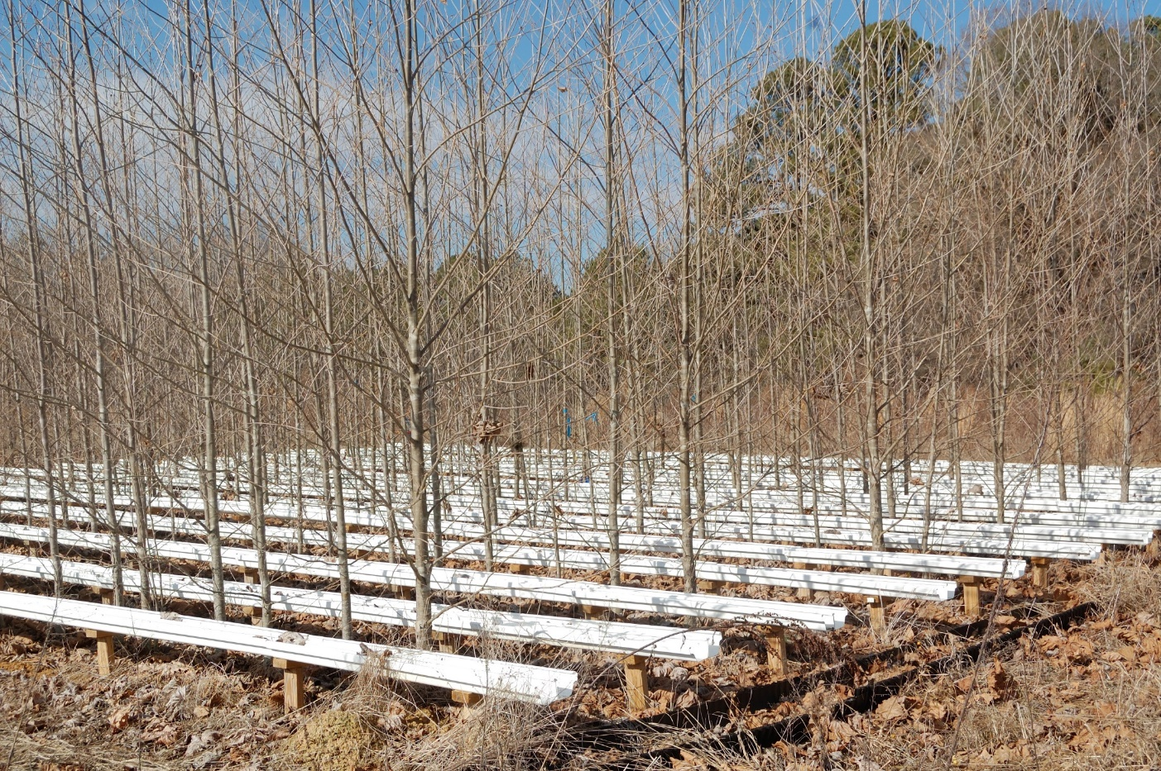
Winter Harvest 2013

Slide 14
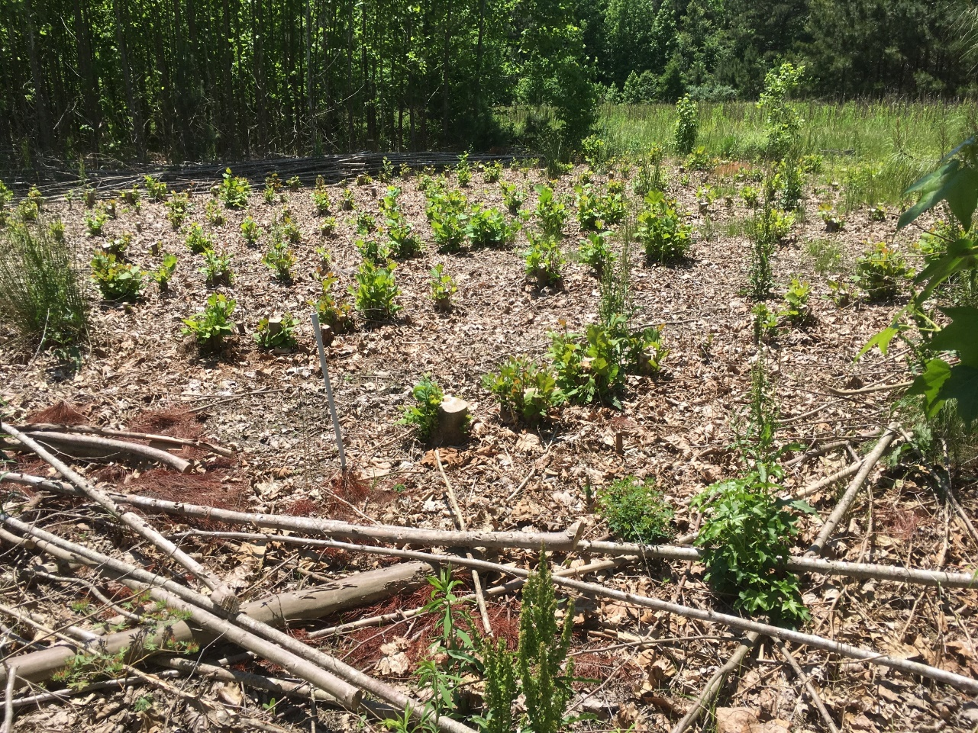
Harvest and Coppice

Slide 15
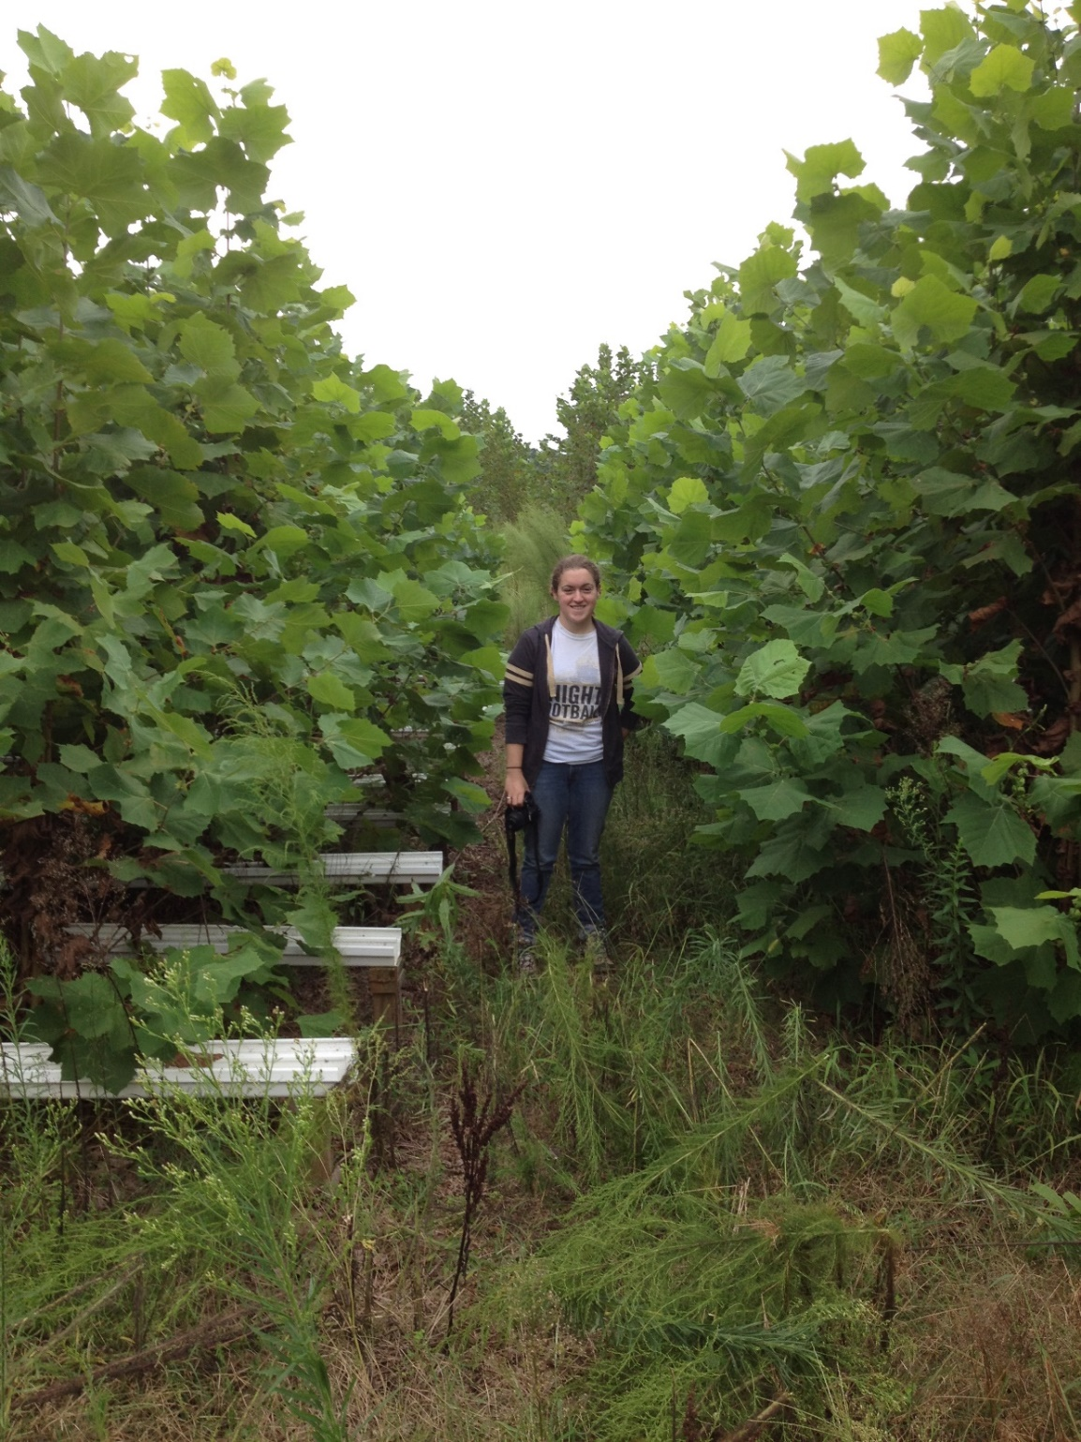
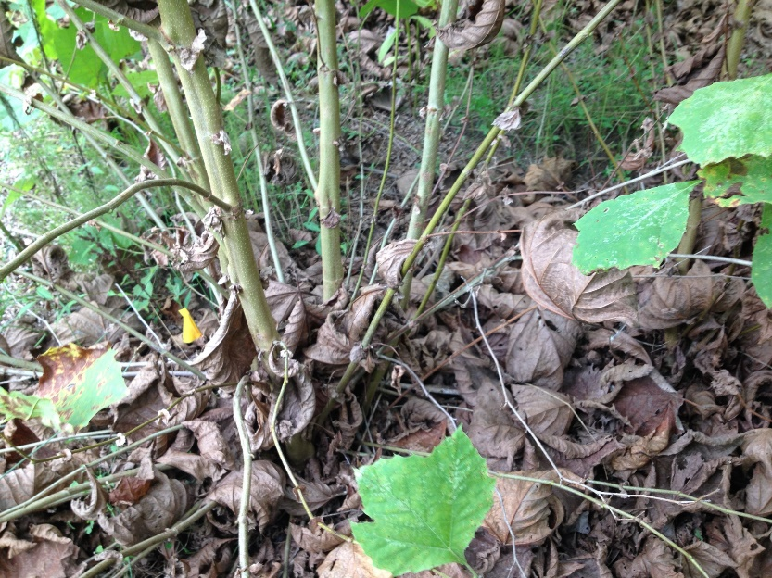
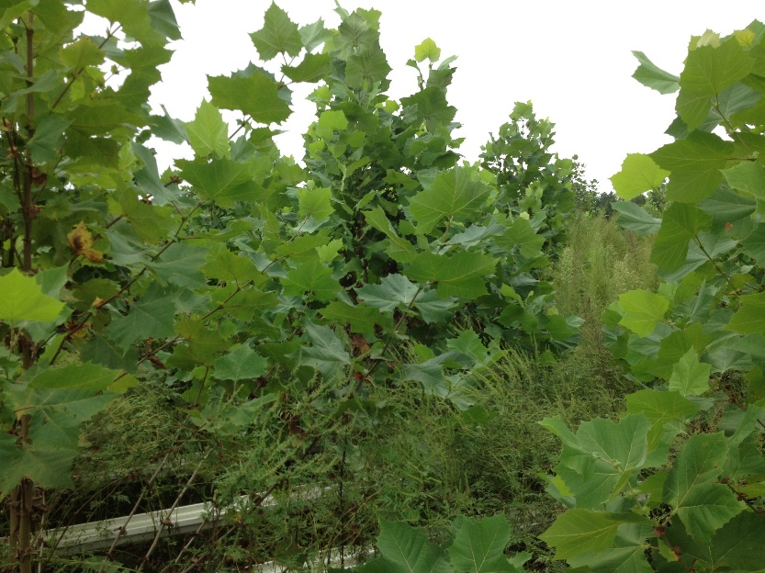
September, 2014

Slide 16
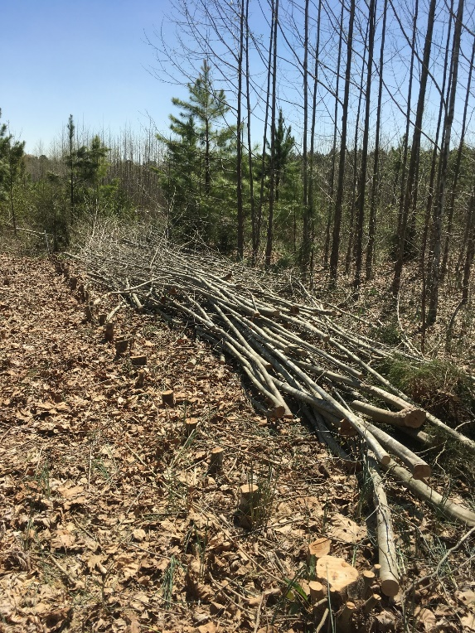
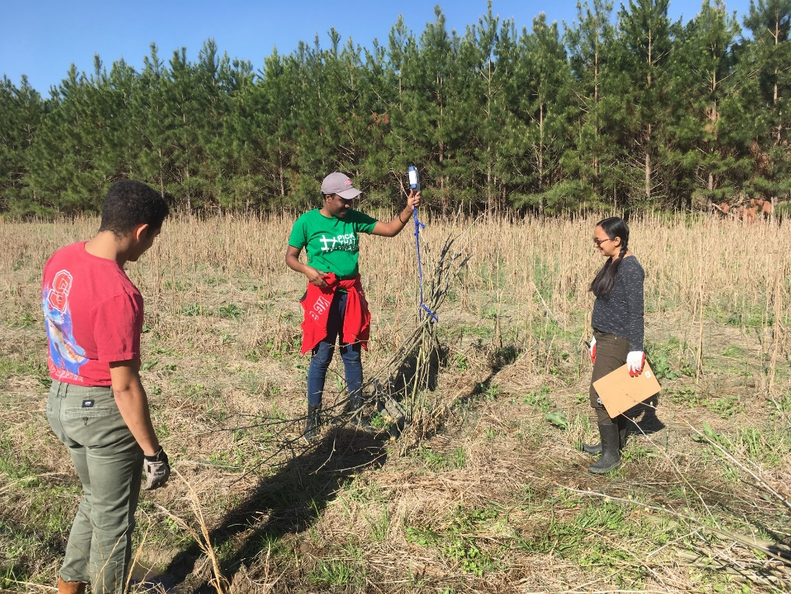
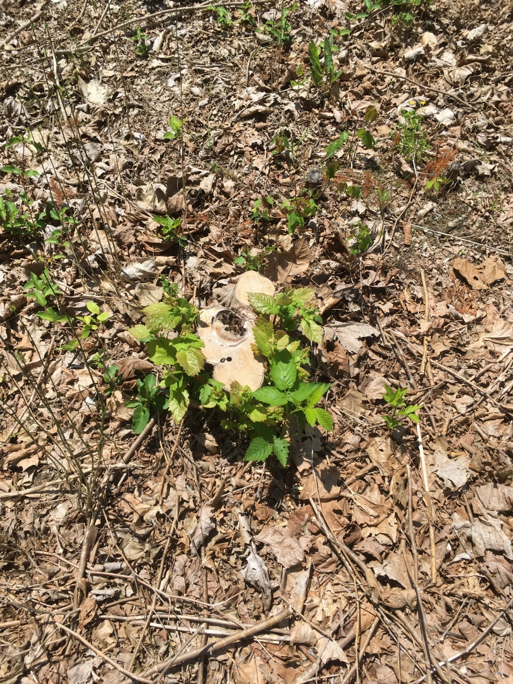
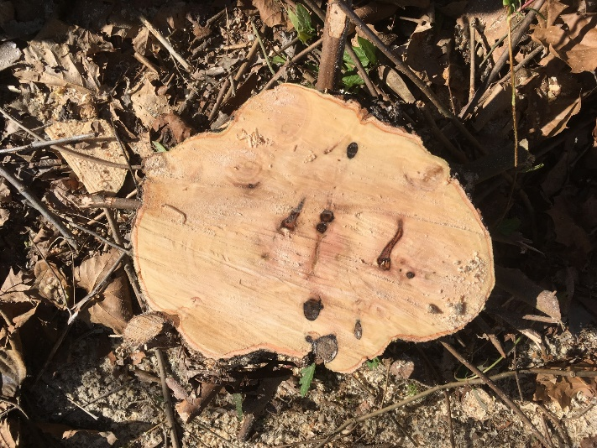
Winter/Spring Harvest 2019

Slide 17
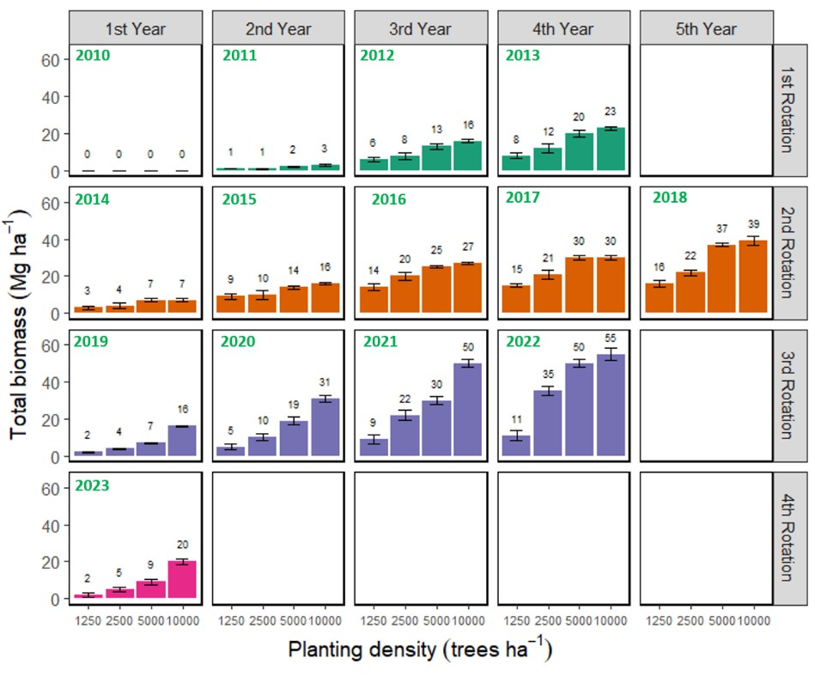

Slide 18
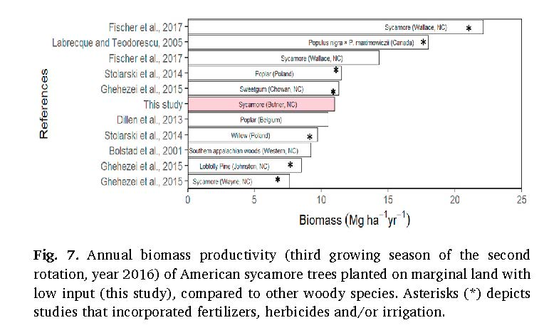

Slide 19
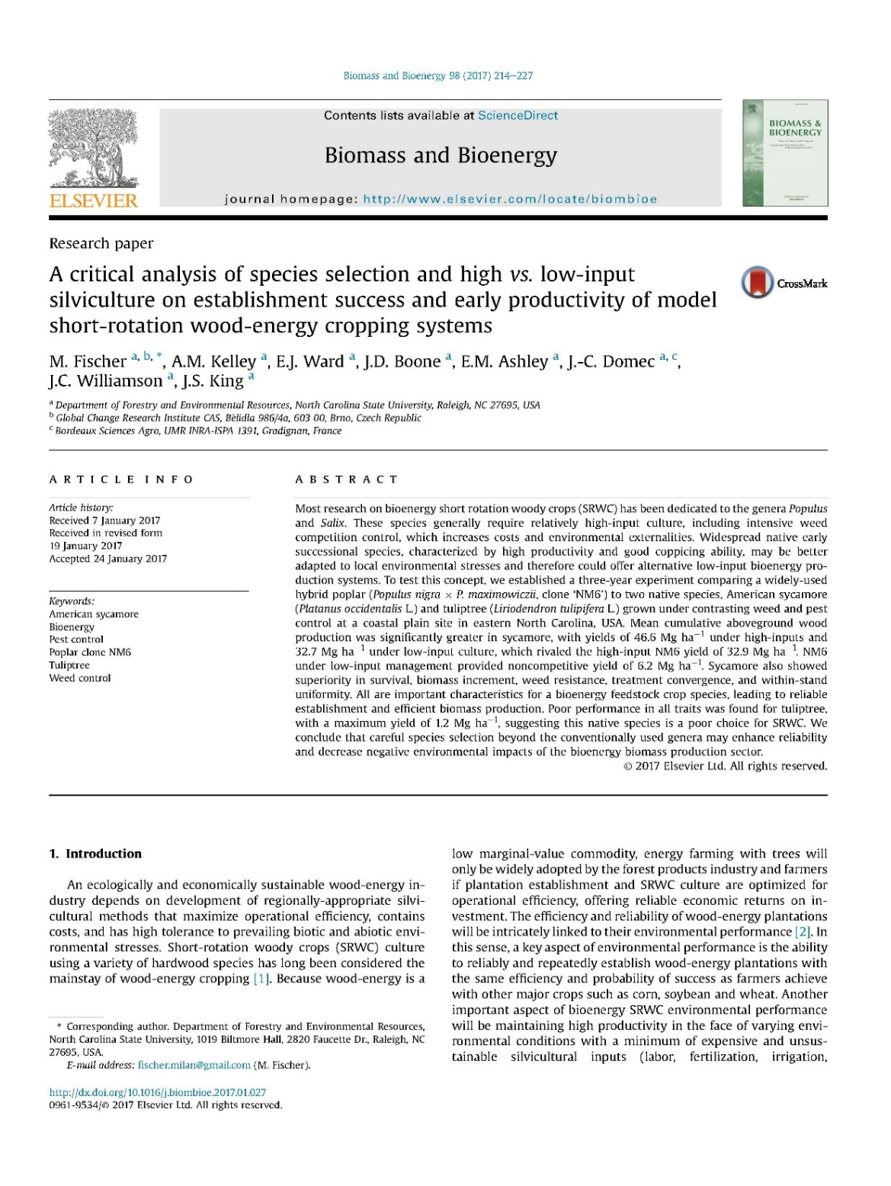
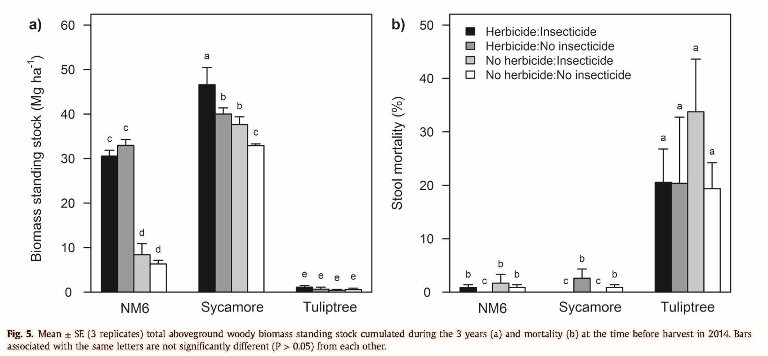
This experience has been repeated multiple times, at multiple sites in eastern and central NC

Slide 20
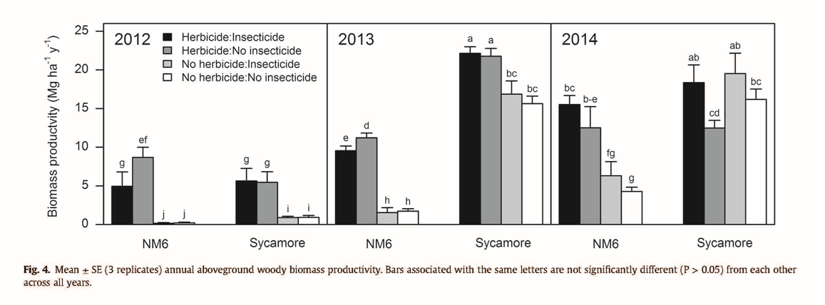
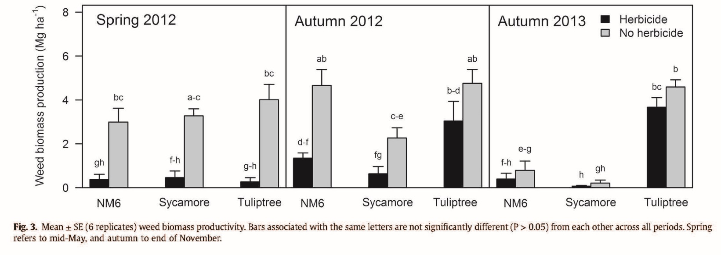
Fischer et al. 2017

Slide 21
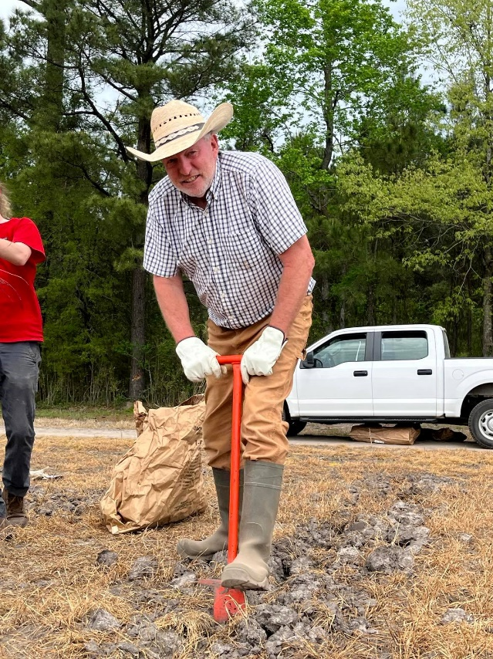
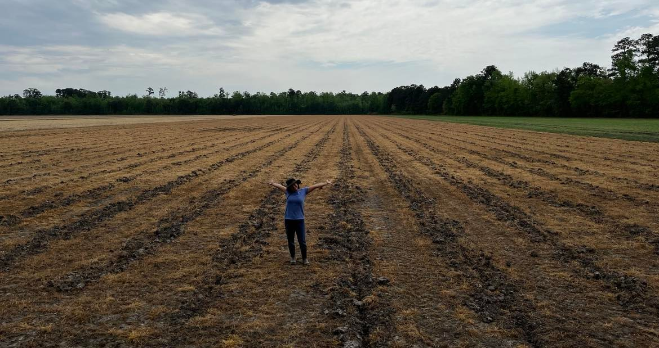
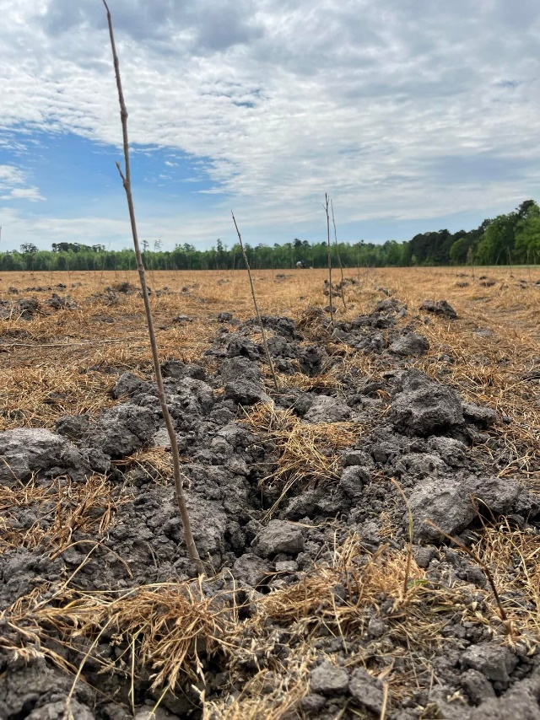
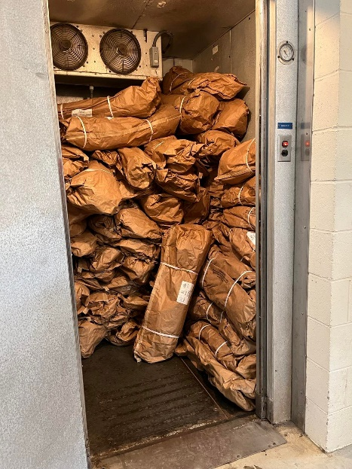
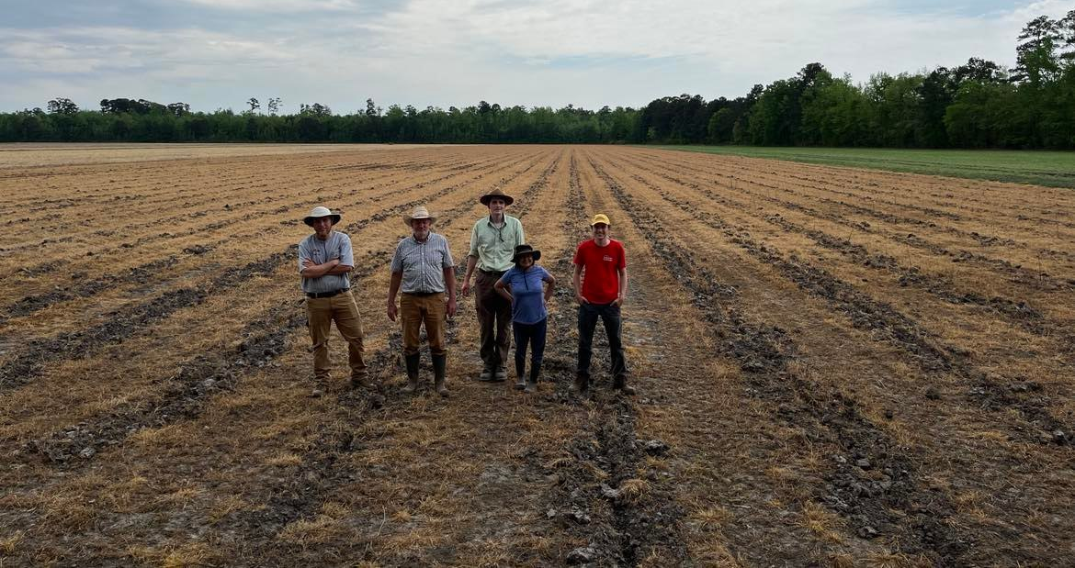
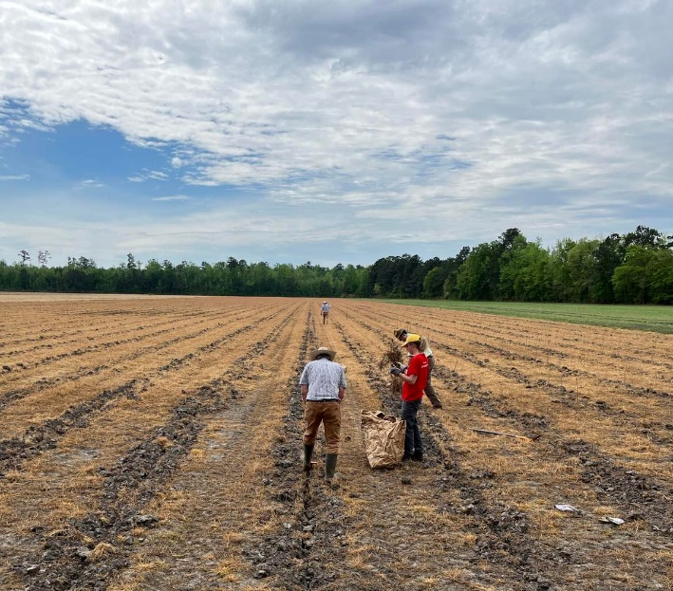
A new Eddy Covariance flux tower for American sycamore bioenergy demo site (April 2023)

Slide 22
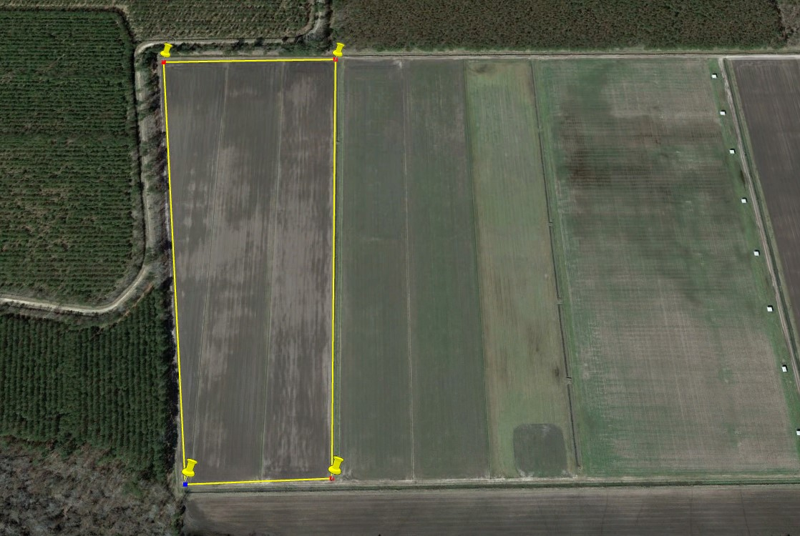
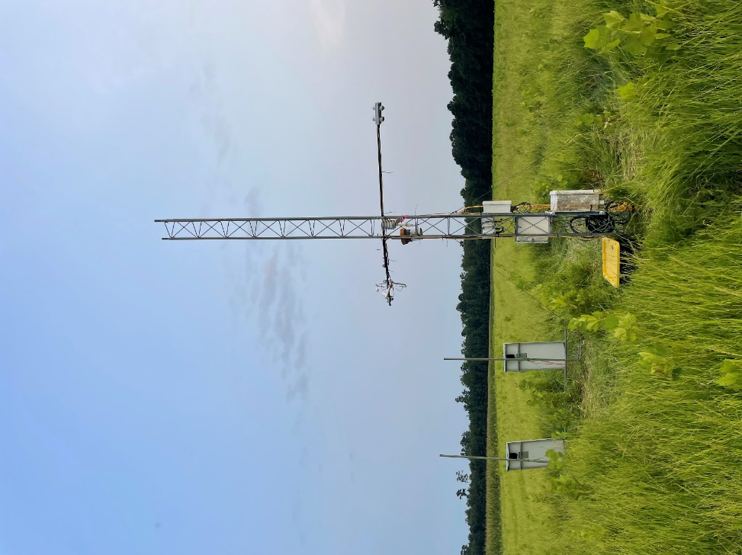
Tidewater research station bioenergy flux site
- Flux data processing on-going
Proposed planting: December 2025
Proposed planting: December 2024
Planted in April 2023

Slide 23
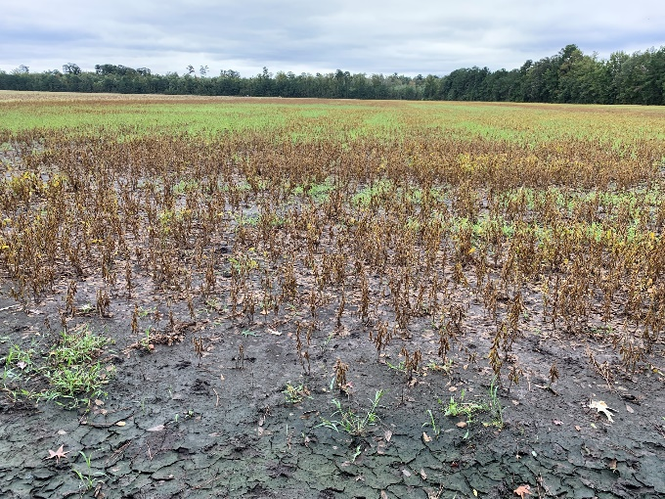
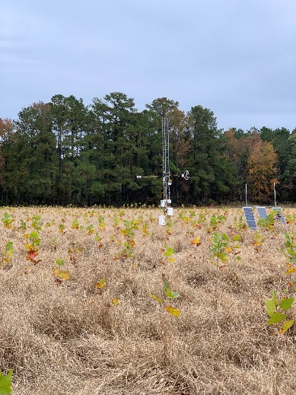
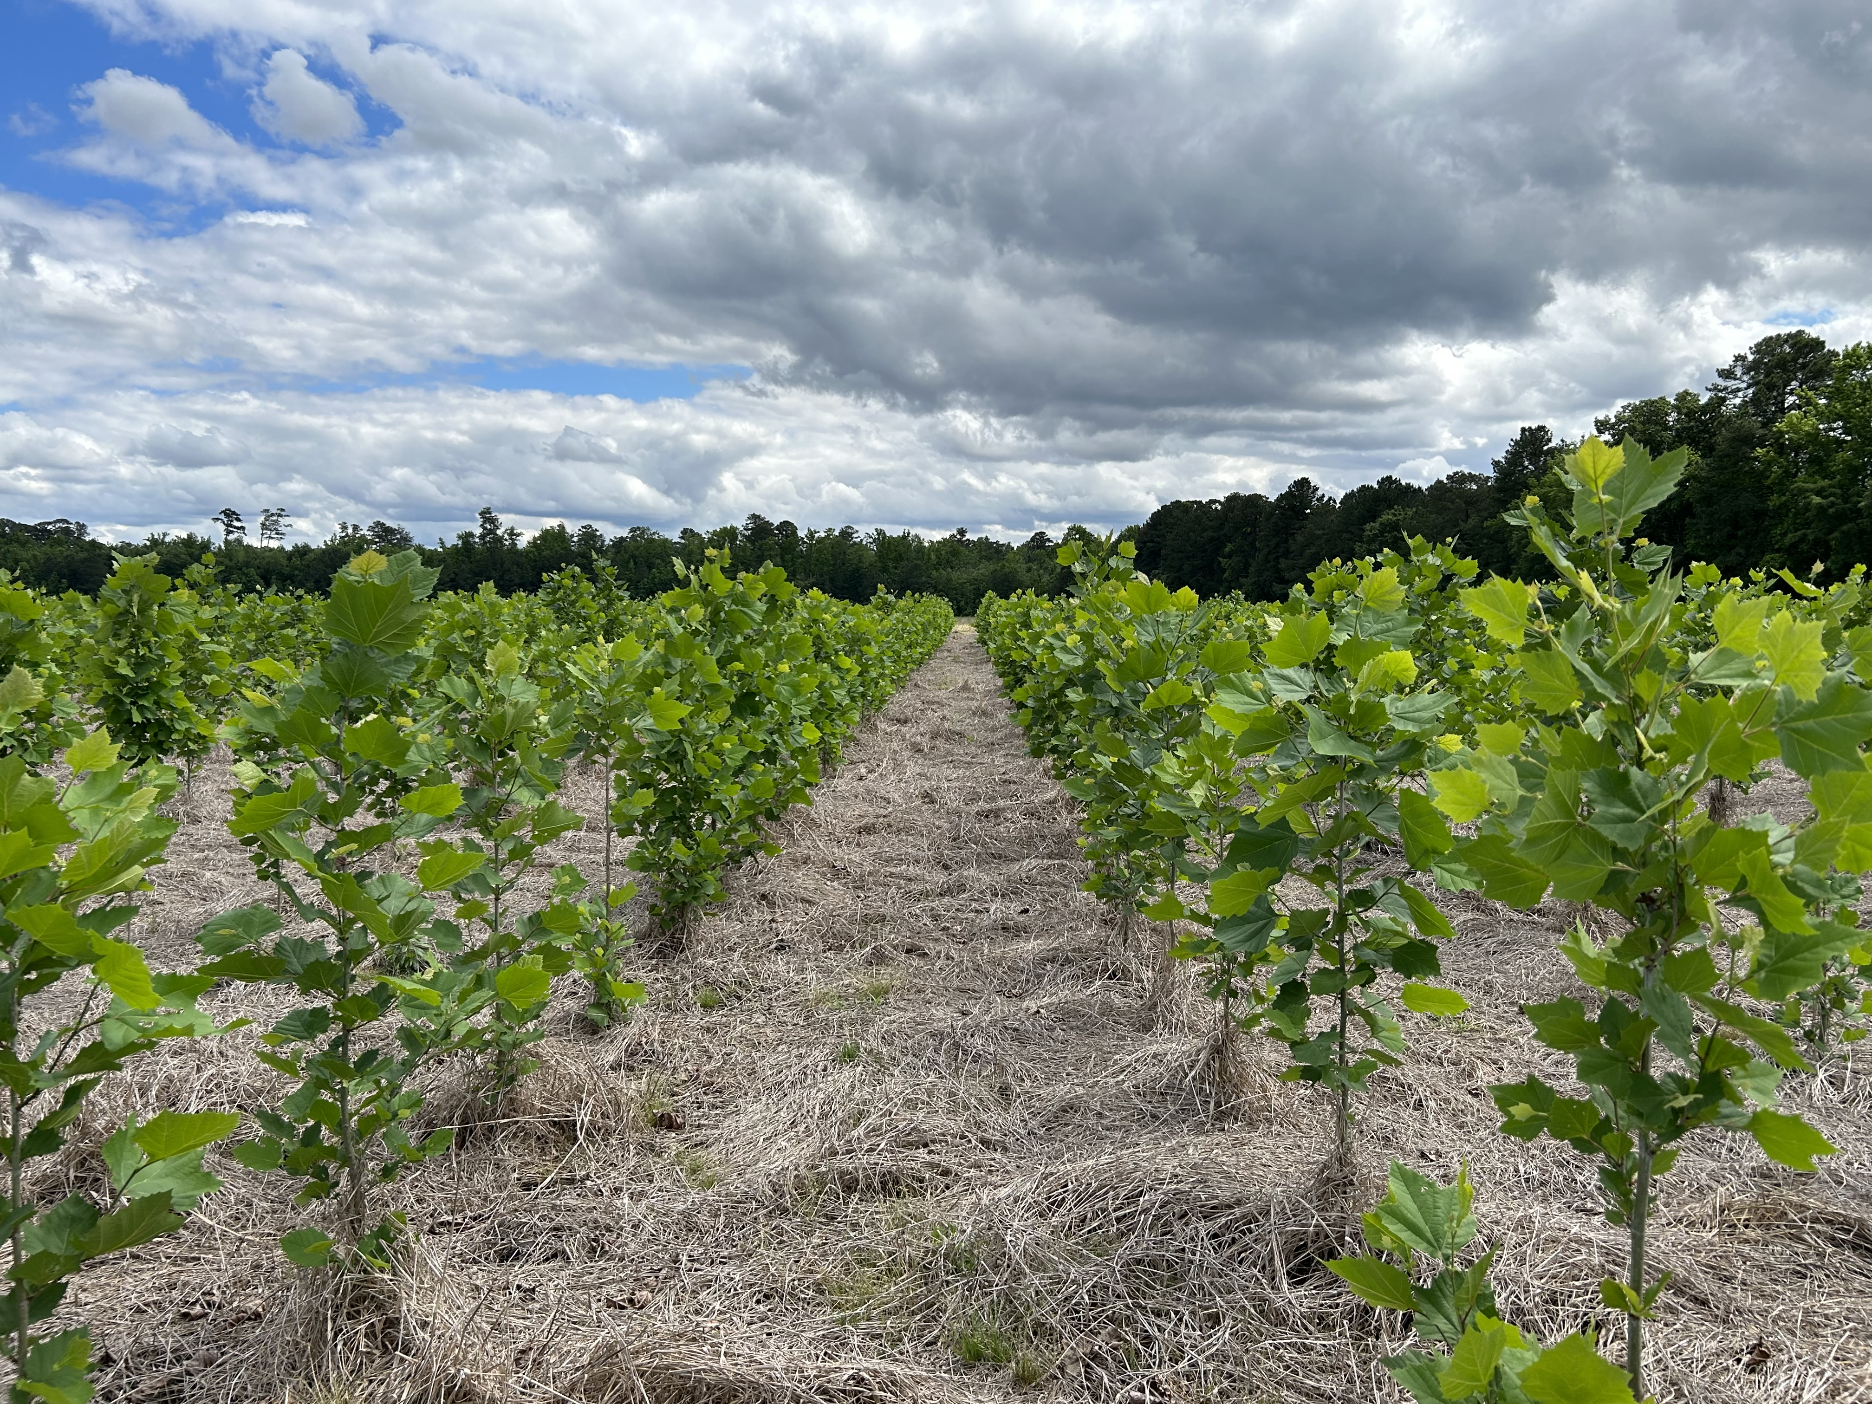
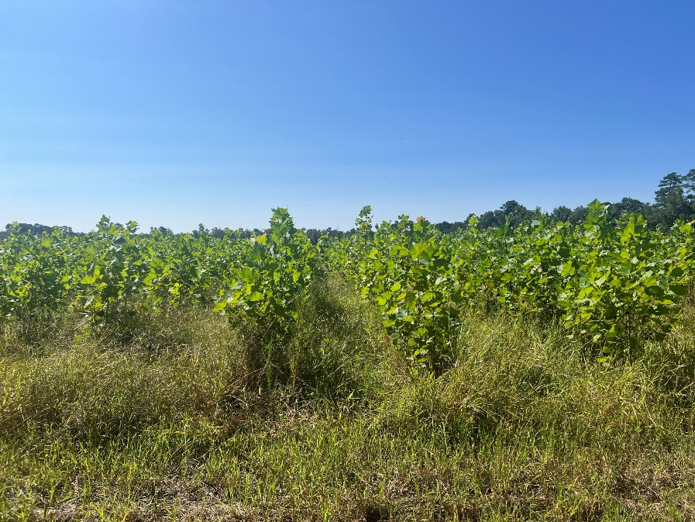
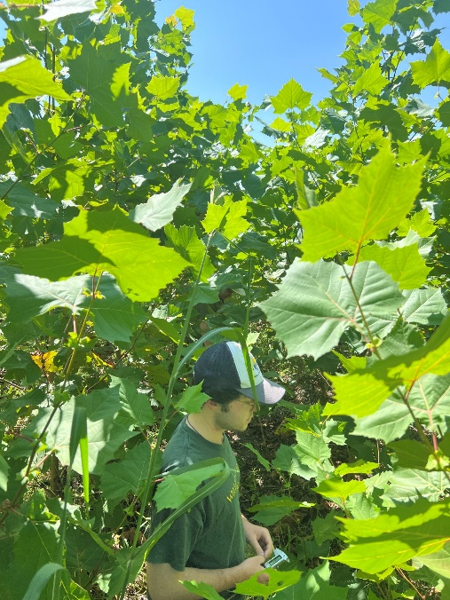
Tidewater again shows American sycamore’s capacity for robust establishment on marginal sites!
October, 2022
April, 2023
November, 2023
May, 2024
September, 2024

Slide 24
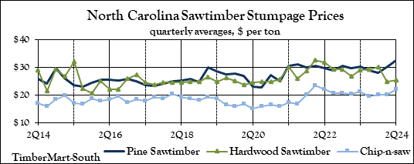
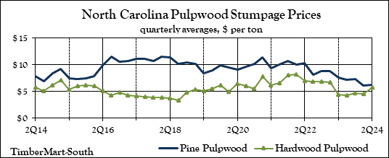
Developing new markets for bioenergy feedstocks and outreach and extension are important next steps
Per acre revenues from BLTFT:
Dry mass = 55 Mg ha⁻¹ at 10,000 TPH after 4 years
= 127.05 US tons ha⁻¹ green weight
Current hardwood pulp price = $6.00 US ton⁻¹
Per acre revenues = $762.30 acre⁻¹
Per acre costs of production = $280.00*
4-year sycamore net revenues per acre = $482.30 or $120.60 y⁻¹
How does this compare to corn?
2023 Durham Cty Average Yield (NCDA) = 111 bu acre⁻¹
Corn price per bu = $7.34, cost of production per bu = $5.12
Annual corn net revenues per acre = $246.42 y⁻¹
*Sycamore cost of production decreases to only cost of
harvesting ($50.00 acre⁻¹) in subsequent rotations,
yielding net per acre revenues of $712.30 or $178.07 y⁻¹
TimberMart-South, 9-11-24; NCDA&CS Ag Statistics, 9-11-24

Slide 25
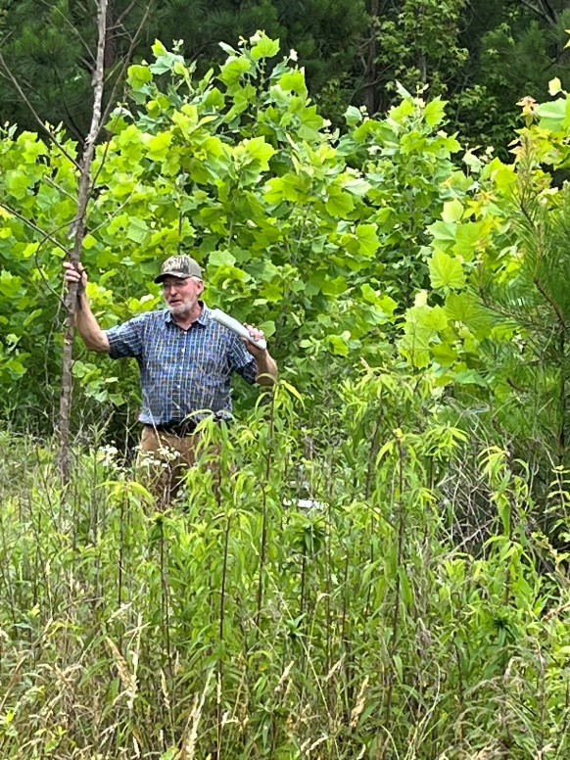
Extension and Outreach
Summer Camps
Field Days
Farmer’s Farm Visit

Slide 26
4. Future directions

Slide 27
Quantify ecosystem services provisioning
Soil chemical, physical and biological properties
ILE et al. 2021

Slide 28
Expand partnerships
North Carolina Bioenergy Research Initiative/Emerging Crops
New project to work with farmers in eastern NC to operationally integrate sycamore and get the word out
Quarterly and Annual Field Days
Fall 2025-Regional bioenergy conference at NCSU
Surveys to identify barriers to adoption
NC Forest Service, seedling production/tree improvement
NC Cooperative Extension, technology transfer
Wood products industry, especially along lower coastal plain
Pellet manufacturers and other constituencies/economic sectors

Slide 29
Bioenergy publications
Ile OJ, Aguilos M, Morkoc S, Heitman J, King JS (2021) Root biomass distribution and soil physical properties of short-rotation coppice American sycamore (Platanus occidentalis L.) grown at different planting densities. Forests 12: 1806.
Ile OJ, Aguilos M, Morkoc S, Minick K, Dome J-C, King JS (2021) Productivity of low-input short-rotation coppice American sycamore (Platanus occidentalis L.) grown at different planting densities as a bioenergy feedstock over two rotation cycles. Biomass and Bioenergy 146: 105983.
Fischer M, Zenone T, Trnka M, Orsag M, Montagnani L, Ward EJ, Tripathi AM, Hlavinka P, Seuf ert G, Zalud Z, King JS, Ceulemans R (2018) Water requirements of short rotation coppice: Experimental and modelling analyses across Europe. Agricultural Forest Meteorology, 250/251: 343-360.
Tian S, Fischer M, Chescheir GM, Youssef MA, Cacho JF, King JS (2018) Microtopography-induced transient waterlogging affects switchgrass (Alamo) growth in the Lower Coastal Plain of North Carolina, USA. Global Change Biology Bioenergy, 10: 577-591.
Fischer M, Zenone T, Trnka M, Orsag M, Montagnani L, Ward EJ, Tripathi AM, Hlavinka P, Seufert G, Zalud Z, King JS, Ceulemans R (2018) Water requirements of short rotation coppice: Experimental and modelling analyses across Europe. Agricultural Forest Meteorology, 250/251: 343-360.
Domec J-C, Ashley E, Fischer M, Noormets A, Boone J, Williamson J, King JS (2017) Productivity, biomass partitioning, and energy yield of low-input American sycamore: Effects of planting density and simulated drought. Bioenergy Research 10: 903-914.
Fischer M, Kelley AM, Ward EJ, Boone JD, Ashley EM, Domec J-C, Williamson JC, King JS (2017) A critical analysis of species selection and high vs. low input silviculture on establishment success and early productivity of model short-rotation wood-energy cropping systems. Biomass and Bioenergy 98: 214-227.
Marchin RM, Stout AT, Davis AA, King JS (2017) Transgencially altered lignin biosynthesis affects photosynthesis and water relations of field-grown Populus trichocarpa. Biomass and Bioenergy 98: 15-25.
Trnka M, Fischer M, Bartosova L, Orsag M, Kyncl T, Ceulemans R, King J, Buntgen U (2016) Potential and limitations of local tree ring records in estimating a priori the growth performance of short-rotation coppice plantations. Biomass and Bioenergy 92: 12-19.
Fischer M, Kelley AM, Ward EJ, Boone JD, Ashley EM, Domec J-C, Williamson JC, King JS (2017) A critical analysis of species selection and high vs. low input silviculture on establishment success and early productivity of model short-rotation wood-energy cropping systems. Biomass and Bioenergy 98: 214-227.
Marchin RM, Stout AT, Davis AA, King JS (2017) Transgenically altered lignin biosynthesis affects photosynthesis and water relations of field-grown Populus trichocarpa. Biomass and Bioenergy 98: 15-25.

Slide 30
Bioenergy publications
Trnka M, Fischer M, Bartosova L, Orsag M, Kyncl T, Ceulemans R, King J, Buntgen U (2016) Potential and limitations of local tree ring records in estimating a priori the growth performance of short-rotation coppice plantations. Biomass and Bioenergy 92: 12-19.
Tian S, Cacho JF, Youssef MA, Chescheir GM, Fischer M, Nettles JE, King JS (2016) Switchgrass growth and pine-switchgrass interactions in established cropping systems. Global Change Biology Bioenergy doi: 10.1111/gcbb.12381.
Albaugh JM, Albaugh TJ, Heiderman RR, Leggett Z, Stape JL, King K, O’Neill KP, King JS (2014) Evaluating changes in switch grass physiology, biomass, and light-use efficiency under artificial shade to estimate yields if intercropped with Pinus taeda L. Agroforestry Systems 88: 489-503.
Stout AT, Davis AA, Domec J-C, Yang C, Shi R, King JS (2014) Growth under field conditions affects lignin content and productivity in transgenic Populus trichocarpa with altered lignin biosynthesis. Biomass and Bioenergy 68: 228-239.
Albaugh JM, Domec J-C, Maier CA, Sucre EB, Leggett ZH, King JS (2014) Gas exchange and stand-level estimates of water use and gross primary productivity in an experimental pine and switch grass intercrop forestry system on the Lower Coastal Plain of North Carolina, USA. Agricultural and Forest Meteorology 192-193: 27-40.
Albaugh JM, Dye PJ, King JS (2013) Eucalyptus and water use in South Africa. International Journal of Forestry Research 852540, 11 p.
Berhongaray, G, Janssens IA, King JS, Ceulemans R (2013) Fine root biomass and turnover of two fast-growing poplar genotypes in a short-rotation coppice culture. Plant Soil 373: 269-283.
King JS, Ceulemans R, Albaugh JM, Dillen SY, Domec J-C, Fichot R, Fischer M, Leggett Z, Sucre E, Trnka M, Zenone T (2013) The challenge of lignocellulosic bioenergy in a water-limited world. BioScience, 63: 102-117.
Djomo SN, El Kasmioui O, De Groote T, Broeckx LS, Verlinden MS, Berhongaray G, Fichot R, Zona D, Dillen SY, King JS, Janssens JA, Ceulemans R (2013) Energy and climate benefits of bioelectricity from low-input short rotation woody crops on agricultural land over a two-year rotation. Applied Energy, 111: 862-870.
Berhongaray G, King JS, Janssens IA, Ceulemans R (2012) An optimized fine root sampling methodology balancing accuracy and time investment. Plant Soil, 366: 351-361.
Albaugh JM, Sucre EB, Leggett Z, Domec J-C, King JS (2012) Evaluation of intercropped switchgrass establishment under a range of experimental site preparation treatments in a forested setting on the Lower Coastal Plain of North Carolina, U.S.A. Biomass and Bioenergy 46: 673-682.

Slide 31
Acknowledgements
Students, postdocs, colleagues who work so hard!
North Carolina Bioenergy Research Initiative/Emerging Crops Programs
NCDACS and NCSU CALS Research Stations
USDA NIFA and USDA Rural Development programs
NC Forest Service
US Forest Service
Weyerhaeuser NR Corporation
Bayer CropSciences
US Department of Energy

